Slide 1
Application of SVD in Recommendation System
AYENAMPUDI YASHWANTH VARMA - AM.EN.U4AIE20015
KALLA YADU VAMSI - AM.EN.U4AIE20039
MARASANI JAYA SURYA - AM.EN.U4AIE20048
S KRISHNA SANDEEP REDDY - AM.EN.U4AIE20061
SISTA SAI SUBRAHMANY MRINAAL - AM.EN.U4AIE20067

Slide 2
Problems Faced
We are doing the SVD based Collaborative Filtering using Latent factors which is based on item-item similarities. The problems faced mentioned below:
Importing data and preprocessing before computation.
Sparse Matrix
Time Complexity for computation is high.

Slide 3
The Methods used :
1) SVD : The Singular Value Decomposition (SVD), a method from linear algebra that has been generally used as a dimensionality reduction technique in machine learning. SVD is a matrix factorisation technique, which reduces the number of features of a dataset by reducing the space dimension from N-dimension to K-dimension (where K<N).
2)Cosine Similarity:Cosine similarity is a metric used to measure how similar the documents are irrespective of their size. Mathematically, it measures the cosine of the angle between two vectors projected in a multi-dimensional space.
3)Latent Factors : Latent factor models (LFMs) are a set of unsupervised methods that model observed high- dimensional data examples by linear combination of latent factors. ... It is very helpful to not only find the common hidden factors but also explore the structural relationship between these latent groups.

Slide 4
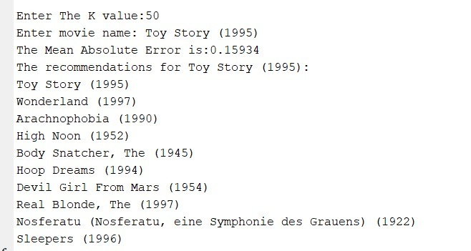
Result And
Discussions
Procedure:
Preprocessing of data
Normalisation of PreProcessed data
SVD
Predicting the ratings using Latent factors
Cosine Similarity

Slide 5
References
1. F. Maxwell Harper and Joseph A. Konstan. 2015. The MovieLens Datasets: History and Context. ACM Transactions on Interactive Intelligent Systems (TiiS) 5, 4, Article 19 (December 2015), 19 pages.
2. ] B.M. Sarwar, et, "Application of Dimensionality Reduction in Recommender System—A Case Study," Proc. KDD Workshop on Web Mining for e-Commerce: Challenges and Opportunities (WebKDD), ACM Press, 2000.
3. Bobadilla, J., Ortega, F., Hernando, A., Gutierrez, A.: Recommender systems survey. KnowledgeBased Systems 46(0), 109–132 (2013)
4. https://arxiv.org/pdf/1804.05090.pdf
5. https://open.metu.edu.tr/bitstream/handle/11511/1 9640/index.pd

